Slide 1

BOOST::BEAST
REST API
USING IN C++

Slide 2
Something about BOOST::BEAST
FOR WHAT? JG REBOOT
REST API
HTTP Protocols
BEAST
BEAST BENCHMARK AGAINST OTHER LIBS
Linking BEAST WITH ASIO
Listener
Session
CONCLUSION
REFERENCES

Slide 3

Something about BOOST::BEAST
What you need to know to understand boost::beast:
Layered Network Model (ISO/OSI)
ASIO
Network Protocols

Slide 4
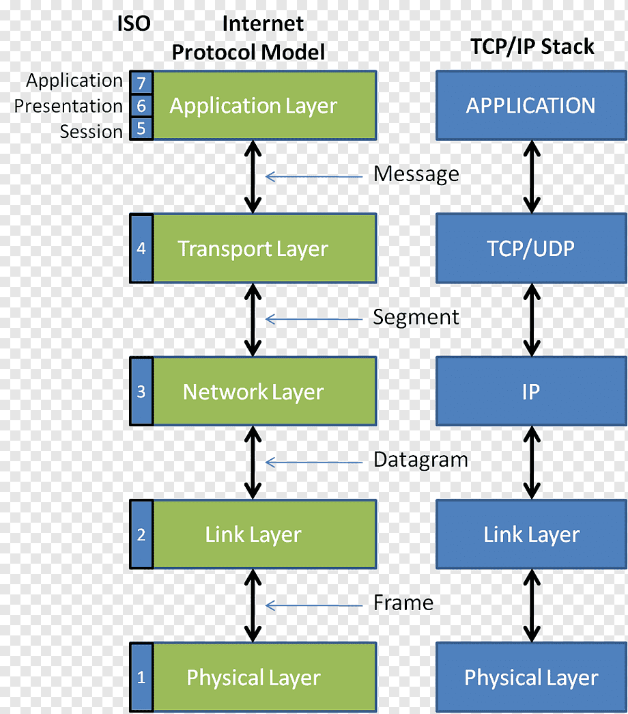
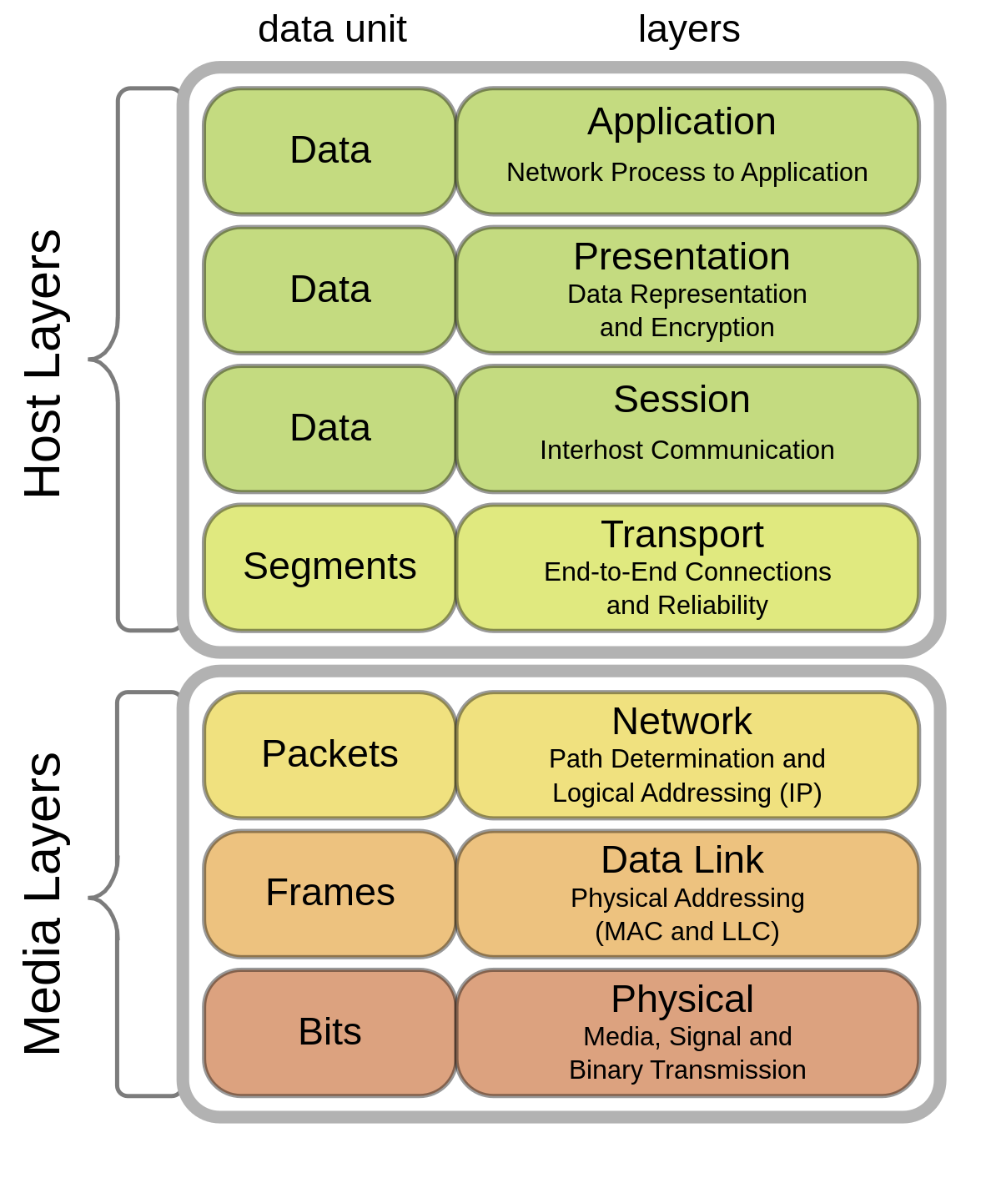
The Internet Protocol Stack Model
Layered Network Model (ISO/OSI)

Slide 5
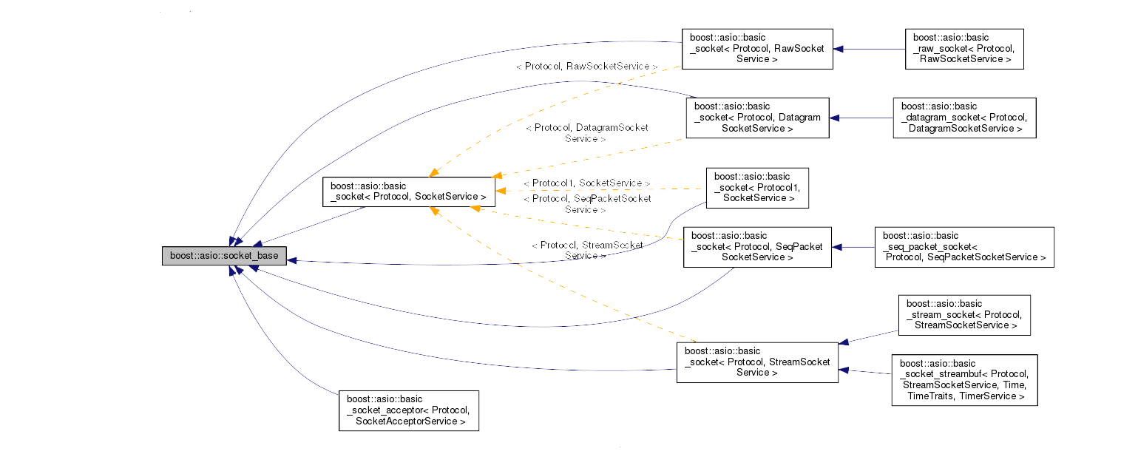
ASIO Model

Slide 6

FOR WHAT?

Slide 7

JG REBOOT

Slide 8
REST API
REST API (Representational State Transfer Application Programming Interface) is an architectural style used to create web services that exchange data with clients over HTTP.
The REST API is used to exchange data between client and server applications using the HTTP protocol.
The REST API relies on the use of standard HTTP methods such as GET, POST, PUT and DELETE to perform operations on resources.
In the REST API, each resource is represented by a unique URL, and client applications can send requests to that address to access the resource.
The REST API uses data formats, such as JSON or XML, to represent resources and transfer data between the client and the server.
The REST API is used in many applications, such as social networks, messengers, online stores, and others, and allows you to create flexible and scalable web services that can exchange data with client applications on different platforms and devices.

Slide 9
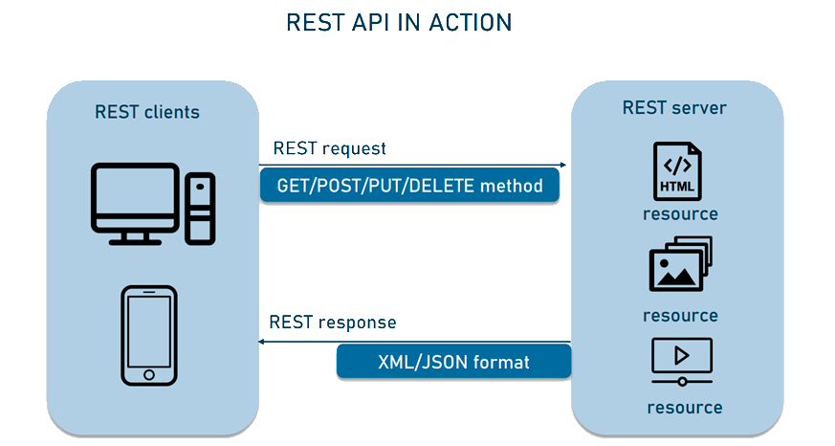
REST API

Slide 10
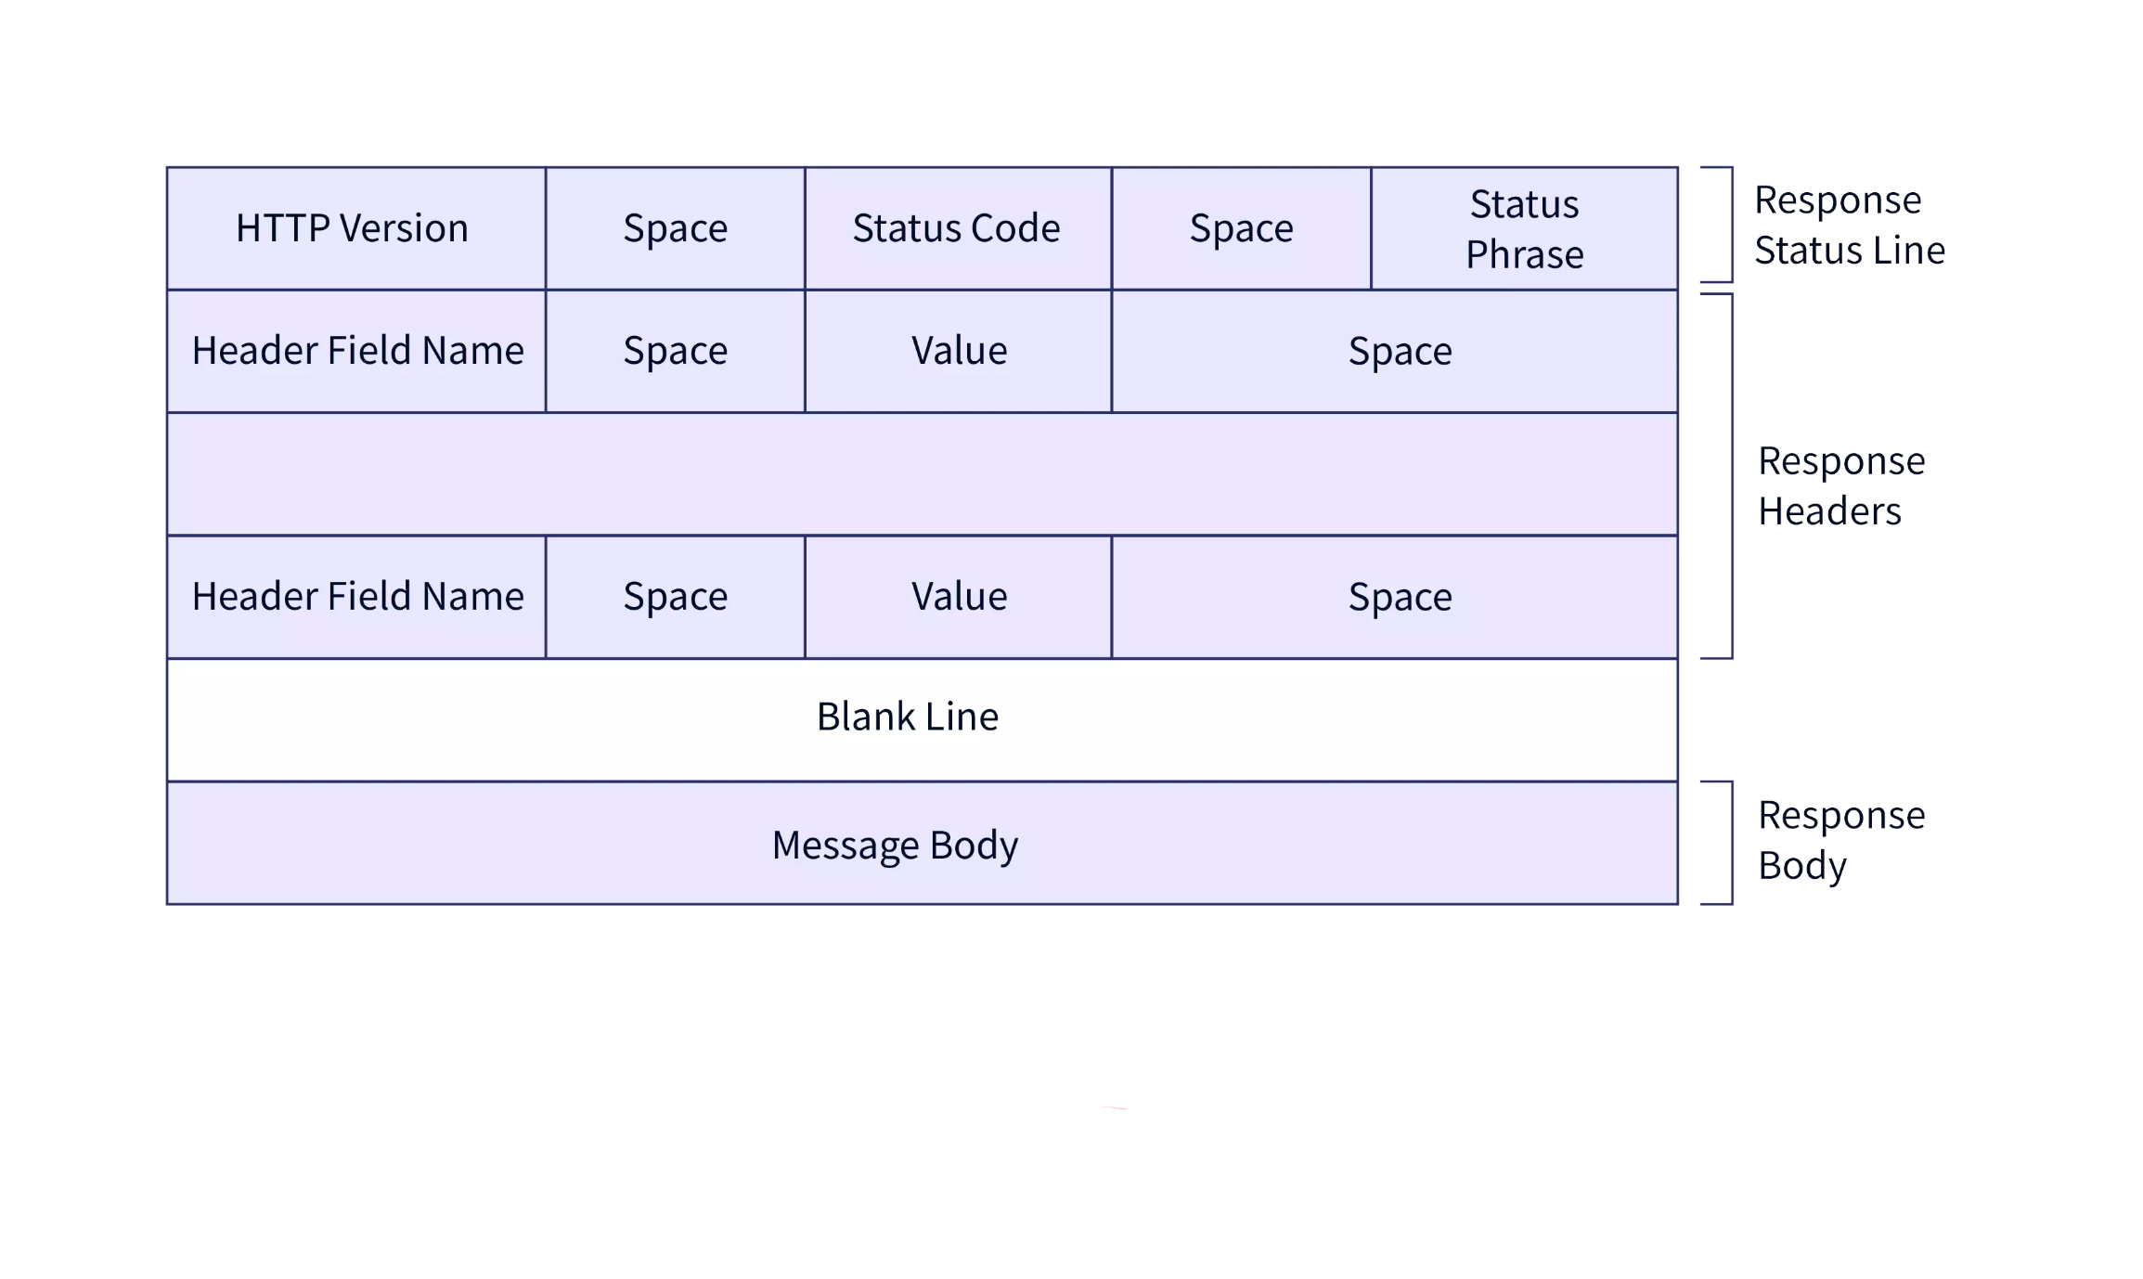
HTTP PROTOCOLS
HyperText Transfer Protocol is an application layer protocol used to
transfer data between a client and a server on the Internet.
There are several versions of the HTTP protocol:
HTTP/0.9
HTTP/1.0
HTTP/1.1
HTTP/2
HTTP/3

Slide 11
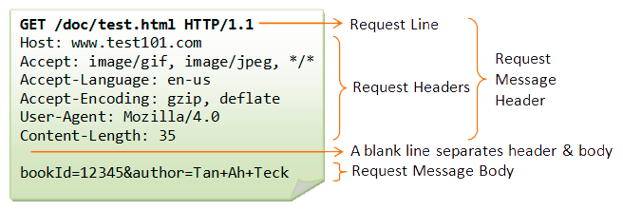
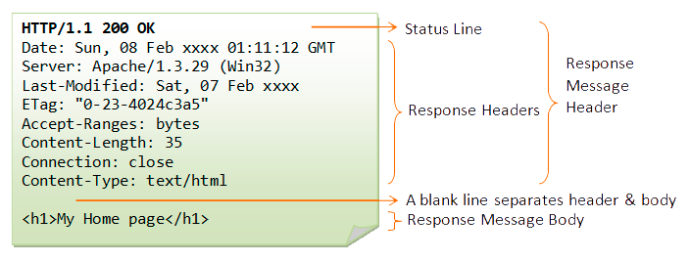
HTTP Request
HTTP Response

Slide 12
HTTP PROTOCOLS

Slide 13
BEAST
Ease of use
High performance
Multithreading support
Multi-protocol support
Cross-platform
Extensibility
Beast supports the following versions of the HTTP protocol:
HTTP/1.0
HTTP/1.1
HTTP/2

Slide 14
BEAST

Slide 15
BEAST BENCHMARK AGAINST OTHER LIBS

Slide 16

ASIO
Asynchronous programming model
Multi-threading support
Support of various protocols
Cross-platform
Ease of use
Wide user community

Slide 17

Linking BEAST WITH ASIO
Beast at its core uses Asio to implement the asynchronous I/O needed to handle HTTP and WebSocket protocols. Asio provides mechanisms for asynchronous data reading and writing as well as for managing network connections.
Thanks to asio, it is possible to use SSL to make a secure HTTPS request.
Thus, Beast and Asio are closely related: Beast uses Asio to implement asynchronous I/O, and Asio provides the necessary functions and classes to handle asynchronous I/O in Beast. Using Asio allows Beast to provide high performance and efficiency with HTTP and WebSocket protocols.

Slide 18

Listener

Slide 19

Session

Slide 20

CONCLUSION

Slide 21



REFERENCES

